Slide 1
Predicting the density of human crowds in the Grand Mosque
Majed mobarak alqahtani
mmk.ksa2021@gmail.co
majed12@pshajj.moi.gov.sa.
0555397778

Slide 2
Table of Content
Design Introduction
Data
MVP
Visualizations
Algorithms
Tools

Slide 3
Design Introduction
Contribute to the development of the promotion process in the Grand Mosque by presenting a technical proposal that enables workers to speed up decision-making and build a knowledge model that is useful in improving crowd movement programs.

Slide 4
Data
Visitor numbers were obtained from the Ministry of Hajj and Umrah
based on the equation for the proportion of human crowds = 4 people per square meter
I expect that technology will be used to determine the target numbers to enter the Grand Mosque

Slide 5
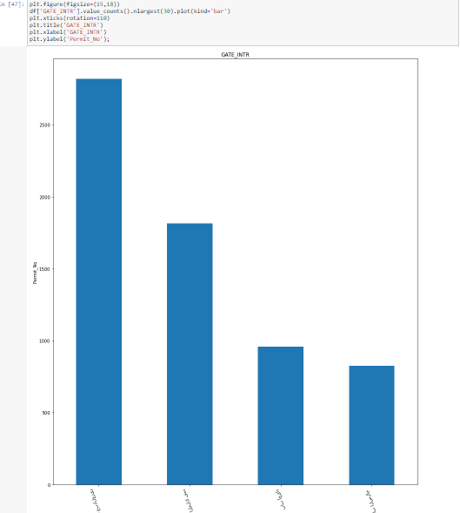
MVP
The goal of this project is to Determining the number of visitors in advance according to the proposed capacity

